Slide 1
Hexaware
Aug 2025
Project 2:
Large-Scale Data Processing
‹#›

Slide 2
Hexaware
Aug 2025
Agenda
01. Project statement
02. Project Overview
03. Prerequisites
04. Azure Resources Used
05. Project Objectives
06. Tools/Technology Used in the Project
07. Source Data Files
08. Execution Overview
09. Implementation -Tasks performed
10. Successful output generated
11. Strategies for Large-Scale Data Processing
12. Conclusion
‹#›

Slide 3
Hexaware
Aug 2025
Project Statement
Implement a project that leverages Azure Databricks and PySpark for large-scale data processing.
Perform ETL operations on massive datasets using PySpark, and utilize Databricks clusters for
scalability.
‹#›

Slide 4
Hexaware
Aug 2025
Project overview
The project focuses on building a scalable ETL pipeline using Azure Databricks. Data is ingested from large CSV/JSON datasets stored in Azure Blob Storage or Data Lake, processed and transformed using PySpark, and stored back into a structured format for downstream analytics. The system is designed to handle millions of records, demonstrating scalability, efficiency, and cost optimization.
‹#›

Slide 5
Hexaware
Aug 2025
Prerequisites
- Azure Subscription: Have an active Azure subscription for
resource management.
- Azure Databricks: Set up an Azure Databricks workspace
for Spark processing.
- Azure Storage Account: Create a storage account in order
to store CSV file .
- Data Source: Ensure availability of the CSV file.
- Databricks Cluster: Set up a Databricks cluster for Spark
jobs.
- Monitoring and Logging: Set up monitoring in Databricks.
‹#›

Slide 6
Hexaware
Aug 2025
Azure Resources Used
Azure Blob Storage – For raw and processed datasets.
Azure Storage Account – As the base storage layer. The implementation relied on the following Azure resources:
Azure Delta Tables – For efficient querying and optimized storage.
‹#›

Slide 7
Hexaware
Aug 2025
Project Objectives:
This project was designed to achieve the following objectives:
Convert raw CSV retail data into optimized Parquet format.
Build a multi-layered architecture: Raw → Processed → transformed.
Implement data quality checks and standard transformations.
Generate actionable insights through advanced analytics.
Improve performance with partitioning and compression.
Schedule a Job to run the notebook
‹#›

Slide 8
Hexaware
Aug 2025
Tools and Technologies Used
Cloud Platform: Microsoft Azure
Processing Engine: Azure Databricks
Programming Language/Framework: PySpark
Data Storage: Azure Blob Storage / Azure Data Lake Storage
Development Interface: Databricks Notebooks
‹#›

Slide 9
Hexaware
Aug 2025
Source Data
Files
We used a Online Retail Dataset from Kaggle
Dataset Link
It contains 5,41,910 rows
‹#›

Slide 10

Hexaware
Aug 2025
Execution Overview
Setup and Configuration
Provision Azure resources (Databricks Workspace + Storage Account).
Create and configure a Databricks cluster suitable for large-scale data processing.
Data Ingestion and Preparation
Upload the source dataset (Online Retail CSV) into Azure Storage.
Set up the Databricks workspace and PySpark environment to enable data transformation.
ETL Development and Execution
Develop ETL scripts in a Databricks notebook using PySpark to read, transform, and process the raw data.
Execute the notebook on the Databricks cluster, with monitoring of Spark jobs and performance.
Data Loading and Validation
Store the transformed output in Azure Storage in an optimized format (e.g., Parquet).
Validate that the data is correctly written, complete, and ready for analysis or further use.
‹#›

Slide 11
Hexaware
Aug 2025
Implementation: Tasks Performed
Provisioned Azure Databricks Workspace, Storage Account, and configured a Databricks cluster.
Uploaded the Online Retail Dataset (CSV) to Azure Storage and prepared the Databricks PySpark environment.
Developed and executed PySpark ETL scripts in a Databricks notebook for data cleaning and transformation.
Stored the transformed data in Parquet format in Azure Storage and validated the output.
Schedule a Job execution and montior the job performance
‹#›

Slide 12
Hexaware
Aug 2025
Practical Implementation
Azure Portal
Databricks Setup: Created a workspace and Spark cluster. Storage Account: Configured raw, source, and destination containers.
Data Upload: Loaded CSV files into the raw container.
Notebooks: Developed ingestion notebooks, transformation notebooks, and analysis notebooks.
Job Schedule: The Customer_analysis notebook was scheduled to run from 26/08/2025, 10:30 PM to 28/08/2025, 10:30 PM.
‹#›

Slide 13
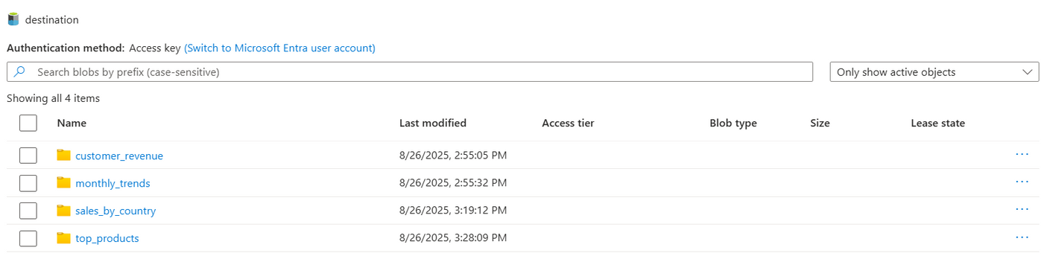
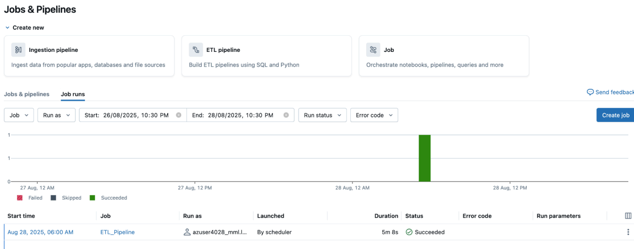
Hexaware
Month Year
Successful output generated
‹#›

Slide 14
Hexaware
Aug 2025
Strategies for Large-Scale Data Processing
Leverage Cluster – Auto-scaling and auto-termination to optimize cost and performance.
Storage & Compute Separation – Blob + Delta Lake for reliable, independent scaling.
Optimized Storage – Partitioning, bucketing, and compression for efficiency.
Modular Pipelines – Reusable ETL notebooks for ingestion, transformation, and analysis.
Monitoring & Security – Job monitoring with Databricks UI/Azure Monitor and secure access controls.
‹#›

Slide 15
Hexaware
Aug 2025
Conclusion:
In conclusion, this project successfully showcases a powerful, scalable, and robust solution for large-scale data processing. By leveraging Azure Databricks clusters, we can distribute the computational load, and with PySpark, we can implement complex data transformations with ease.
The solution highlights:
Scalable data processing with Databricks clusters.
Efficient storage using Parquet/Delta formats.
Reusable, automated ETL pipelines.
Improved query speed and resource optimization.
This architecture serves as a foundational blueprint for building enterprise-grade ETL pipelines capable of handling the demands of big data.
‹#›

Slide 16
Hexaware
Aug 2025
Thank you
‹#›

